Slide 1
Round Robin Scheduling-

Slide 2
CPU is assigned to the process on the basis of FCFS for a fixed amount of time.
This fixed amount of time is called as time quantum or time slice.
After the time quantum expires, the running process is preempted and sent to the ready queue.
Then, the processor is assigned to the next arrived process.
It is always preemptive in nature.

Slide 3
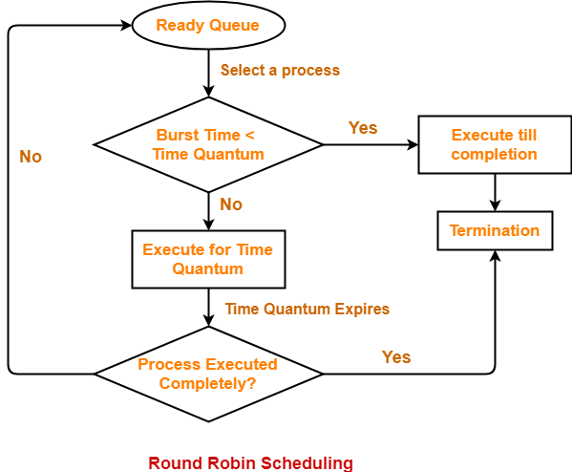

Slide 4
Advantages-
It gives the best performance in terms of average response time.
It is best suited for time sharing system, client server architecture and interactive system.
Disadvantages-
It leads to starvation for processes with larger burst time as they have to repeat the cycle many times.
Its performance heavily depends on time quantum.
Priorities can not be set for the processes.

Slide 5
Important
With decreasing value of time quantum,
Number of context switch increases
Response time decreases
Chances of starvation decreases
Thus, smaller value of time quantum is better in terms of response time.

Slide 6
Important
With increasing value of time quantum,
Number of context switch decreases
Response time increases
Chances of starvation increases
Thus, higher value of time quantum is better in terms of number of context switch.

Slide 7
Important
With increasing value of time quantum, Round Robin Scheduling tends to become FCFS Scheduling.
When time quantum tends to infinity, Round Robin Scheduling becomes FCFS Scheduling.

Slide 8
Important
The performance of Round Robin scheduling heavily depends on the value of time quantum.
The value of time quantum should be such that it is neither too big nor too small.

Slide 9
Problem-01:
Consider the set of 5 processes whose arrival time and burst time are given below-
If the CPU scheduling policy is Round Robin with time quantum = 2 unit, calculate the average waiting time and average turn around time.
Process Id | Arrival time | Burst time
P1 | 0 | 5
P2 | 1 | 3
P3 | 2 | 1
P4 | 3 | 2
P5 | 4 | 3

Slide 10
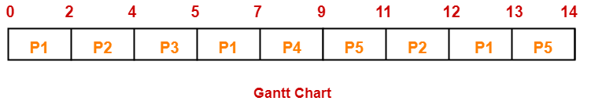

Slide 11
Process Id | Exit time | Turn Around time | Waiting time
P1 | 13 | 13 – 0 = 13 | 13 – 5 = 8
P2 | 12 | 12 – 1 = 11 | 11 – 3 = 8
P3 | 5 | 5 – 2 = 3 | 3 – 1 = 2
P4 | 9 | 9 – 3 = 6 | 6 – 2 = 4
P5 | 14 | 14 – 4 = 10 | 10 – 3 = 7
Now,
Average Turn Around time = (13 + 11 + 3 + 6 + 10) / 5 = 43 / 5 = 8.6 unit
Average waiting time = (8 + 8 + 2 + 4 + 7) / 5 = 29 / 5 = 5.8 unit

Slide 12
Problem-02:
Consider the set of 6 processes whose arrival time and burst time are given below-
If the CPU scheduling policy is Round Robin with time quantum = 2, calculate the average waiting time and average turn around time.
Process Id | Arrival time | Burst time
P1 | 0 | 4
P2 | 1 | 5
P3 | 2 | 2
P4 | 3 | 1
P5 | 4 | 6
P6 | 6 | 3

Slide 13
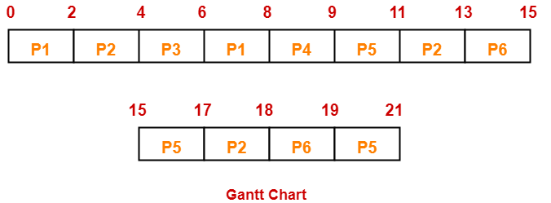

Slide 14
Now,
Average Turn Around time = (8 + 17 + 4 + 6 + 17 + 13) / 6 = 65 / 6 = 10.84 unit
Average waiting time = (4 + 12 + 2 + 5 + 11 + 10) / 6 = 44 / 6 = 7.33 unit
Process Id | Exit time | Turn Around time | Waiting time
P1 | 8 | 8 – 0 = 8 | 8 – 4 = 4
P2 | 18 | 18 – 1 = 17 | 17 – 5 = 12
P3 | 6 | 6 – 2 = 4 | 4 – 2 = 2
P4 | 9 | 9 – 3 = 6 | 6 – 1 = 5
P5 | 21 | 21 – 4 = 17 | 17 – 6 = 11
P6 | 19 | 19 – 6 = 13 | 13 – 3 = 10

Slide 15
Problem-03:
Consider the set of 6 processes whose arrival time and burst time are given below-
If the CPU scheduling policy is Round Robin with time quantum = 3, calculate the average waiting time and average turn around time.
Process Id | Arrival time | Burst time
P1 | 5 | 5
P2 | 4 | 6
P3 | 3 | 7
P4 | 1 | 9
P5 | 2 | 2
P6 | 6 | 3

Slide 16
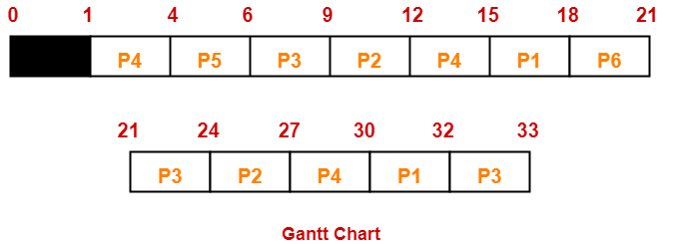

Slide 17
Now,
Average Turn Around time = (27 + 23 + 30 + 29 + 4 + 15) / 6 = 128 / 6 = 21.33 unit
Average waiting time = (22 + 17 + 23 + 20 + 2 + 12) / 6 = 96 / 6 = 16 unit
Process Id | Exit time | Turn Around time | Waiting time
P1 | 32 | 32 – 5 = 27 | 27 – 5 = 22
P2 | 27 | 27 – 4 = 23 | 23 – 6 = 17
P3 | 33 | 33 – 3 = 30 | 30 – 7 = 23
P4 | 30 | 30 – 1 = 29 | 29 – 9 = 20
P5 | 6 | 6 – 2 = 4 | 4 – 2 = 2
P6 | 21 | 21 – 6 = 15 | 15 – 3 = 12

Slide 18
Problem-04:
Four jobs to be executed on a single processor system arrive at time 0 in the order A, B, C, D. Their burst CPU time requirements are 4, 1, 8, 1 time units respectively. The completion time of A under round robin scheduling with time slice of one time unit is-
10
4
8
9

Slide 19
Solution-
Process Id | Arrival time | Burst time
A | 0 | 4
B | 0 | 1
C | 0 | 8
D | 0 | 1

Slide 20
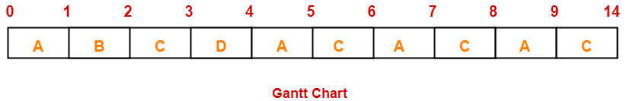
Ready Queue-
C, A, C, A, C, A, D, C, B, A
Clearly, completion time of process A = 9 unit.

